Slide 1
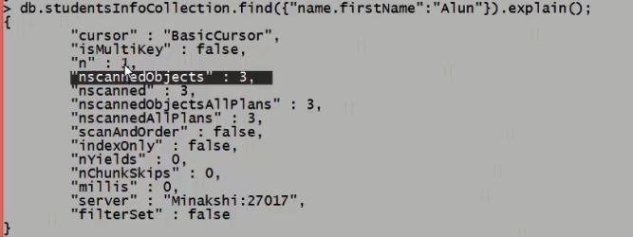
Understanding Impact of Indexes

Slide 2
NoSQL(Not Only SQL) Database
06 Performance tuning with Indexes in MongoDB_d

